Slide 1
ARM controllers:
Introduction:
The British computer manufacturer Acorn Computers first developed the Acorn RISC Machine architecture (ARM) in the 1980s to use in its personal computers. The official Acorn RISC Machine project started in October 1983. They chose VLSI Technology as the silicon partner, as they were a source of ROMs and custom chips for Acorn. Wilson and Furber led the design.
https://www.mepits.com/tutorial/194/arm/arm.
Some of the advantages of ARM processors are listed below:
They are cheap as compared to other processors.
They are designed with such features that it consumes less power.
The devices with ARM processor can have a much better battery life than other processors.
They perform one operation at a time and thus work faster.
The availability and applications support has also made the users choose ARM processors.

Slide 2
ARM processors are a particular type of processors which are made by the ARM holdings PLC. This processor is also known as Reduced Instruction Set Computing (RISC) in which simple central processing units produce a high performance quality for the users. It has 32 bits RISC load architecture. Nowadays ARM processor are widely used in a number of electronic products such as mobile phones, tablets, multi-media players and many more electrical devices. The direct administration of the memory is not possible in this design and is handled by the use of registers. They are also used in personal digital assistants, digital media and music layers, hand-held gaming systems, and hard drives of the computer.
ARM processors vs. Intel processors: When you purchase a processor you will get to know that some of the designs use Intel Atom processors while the other uses ARM architecture. These both processors are designed in a way for low-power operation. They are created to give the mobile a long battery life. But they are both based on different ideology. The ARM structure is made very simple and is intended to keep the energy wastage to the minimum. Intel processors are made of complicated designs to match the compatibility of the company‘s desktop and laptop CPU’s. ARM processors are being used in the portable devices from a very long time but Intel has just entered to this area. Intel is believed to have a serious competition with the ARM technology. The power chips of ARM processors are relatively low in price, so if Intel will have to reconsider their pricing strategies to compete with it. The entry of ARM processors and their wide usage has forced Intel to increase their efficiency.

Slide 3
Simulation is the process of using a simulation software (simulator) to verify the functional correctness of a digital design that is modeled using a HDL (hardware description language) like Verilog.
Synthesis is a process in which a design behavior that is modeled using a HDL is translated into an implementation consisting of logic gates. This is done by a synthesis tool which is another software program.
Difference between 8051, AVR, PIC, ARM microcontrollers:
https://www.elprocus.com/difference-between-avr-arm-8051-and-pic-microcontroller/.
http://www.firmcodes.com/difference-arm-microcontrollers/.

Slide 4
8051 Microcontroller
8051 microcontroller is an 8-bit family of microcontroller is developed by the Intel in the year 1981. This is one of the popular families of microcontroller are being used all across the world. This microcontroller was moreover referred as “system on a chip” since it has 128 bytes of RAM, 4Kbytes of a ROM, 2 Timers, 1 Serial port, and 4 ports on a single chip. The CPU can also work for 8bits of data at a time since 8051 is an 8-bit processor. In case the data is bigger than 8 bits, then it has to be broken into parts so that the CPU can process easily. Most manufacturers contain put 4Kbytes of ROM even though the number of ROM can be exceeded up to 64 K bytes.
PIC Microcontroller
Peripheral Interface Controller (PIC) is microcontroller developed by a Microchip, PIC microcontroller is fast and simple to implement program when we contrast other microcontrollers like 8051. The ease of programming and simple to interfacing with other peripherals PIC become successful microcontroller. We know that microcontroller is an integrated chip which is consists of RAM, ROM, CPU, TIMER and COUNTERS. The PIC is a microcontroller which as well consists of RAM, ROM, CPU, timer, counter, ADC (analog to digital converters), DAC (digital to analog converter). PIC Microcontroller also support the protocols like CAN, SPI, UART for an interfacing with additional peripherals. PIC mostly used to modify Harvard architecture and also supports RISC (Reduced Instruction Set Computer) by the above requirement RISC and Harvard we can simply that PIC is faster than the 8051 based controllers which is prepared up of Von-Newman architecture.

Slide 5
AVR Microcontroller
AVR microcontroller was developed in the year of 1996 by Atmel Corporation. The structural design of AVR was developed by the Alf-Egil Bogen and Vegard Wollan. AVR derives its name from its developers and stands for Alf-Egil Bogen Vegard Wollan RISC microcontroller, also known as Advanced Virtual RISC. The AT90S8515 was the initial microcontroller which was based on the AVR architecture, though the first microcontroller to hit the commercial market was AT90S1200 in the year 1997.
AVR Microcontrollers are Available in three Categories:
TinyAVR:- Less memory, small size, appropriate just for simpler applications.
MegaAVR:- These are the mainly popular ones having a good quantity of memory (up to 256 KB), higher number of inbuilt peripherals and appropriate for modest to complex applications.
XmegaAVR:- Used in commercial for complex applications, which need large program memory and high speed.

Slide 6
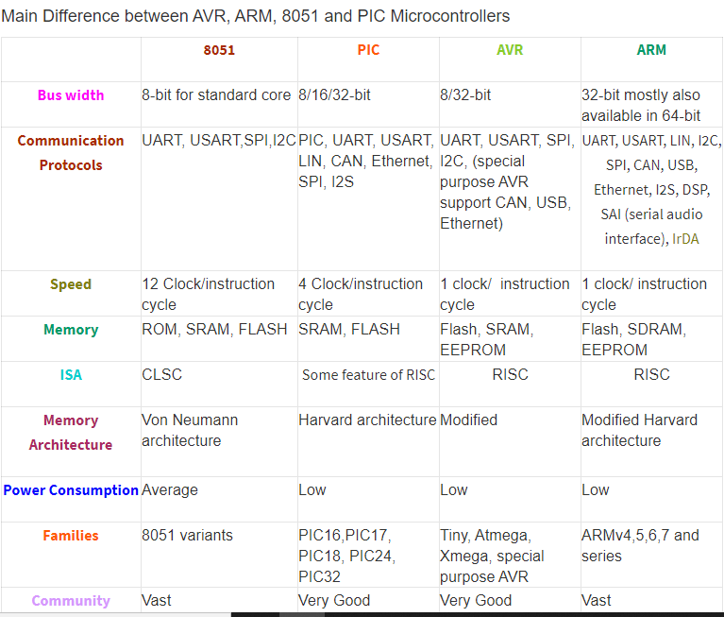

Slide 7
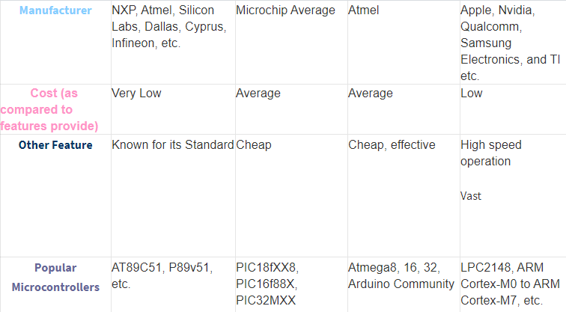

Slide 8
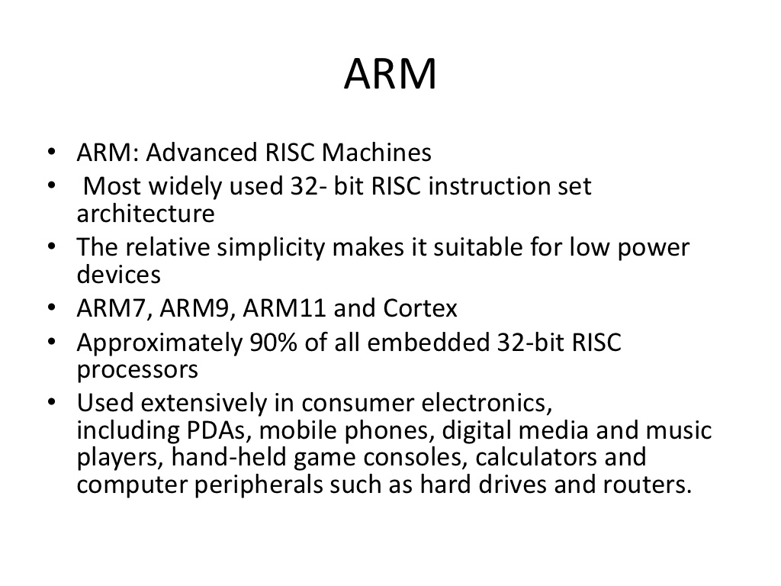

Slide 9
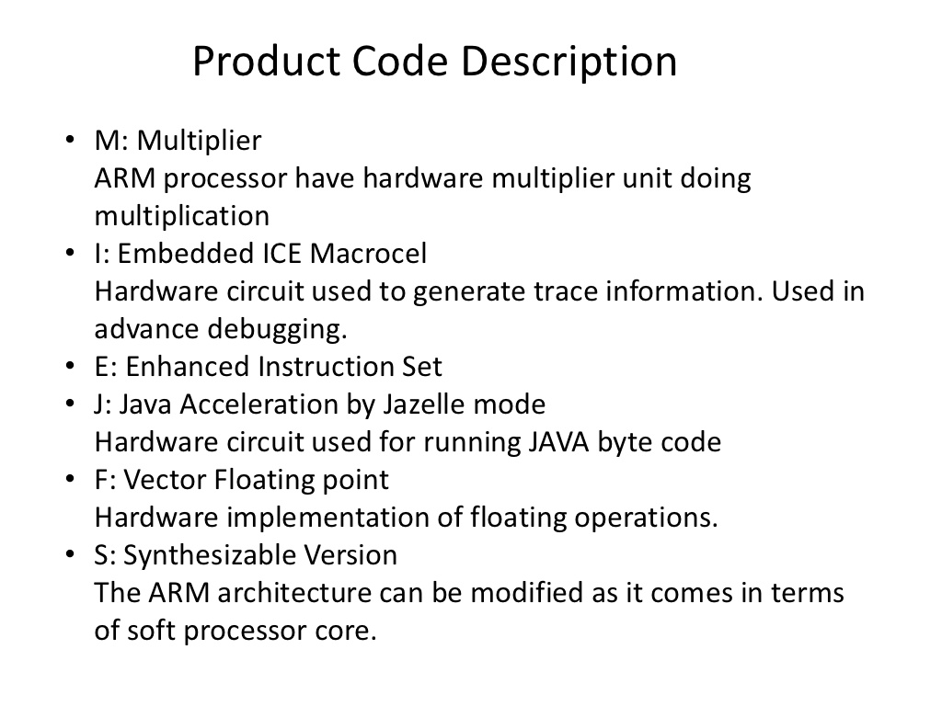

Slide 10
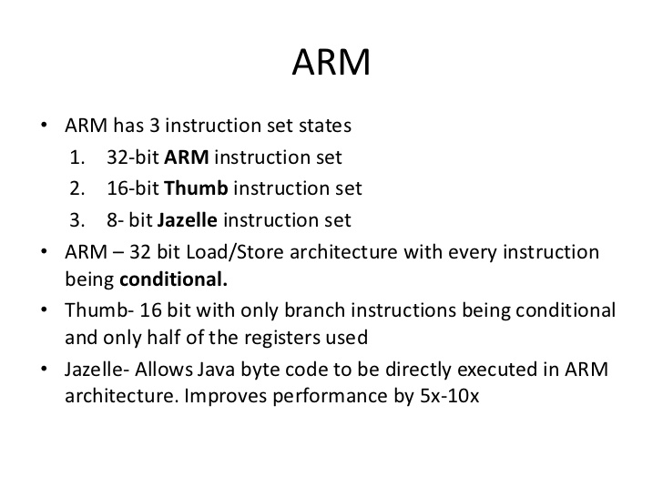

Slide 11
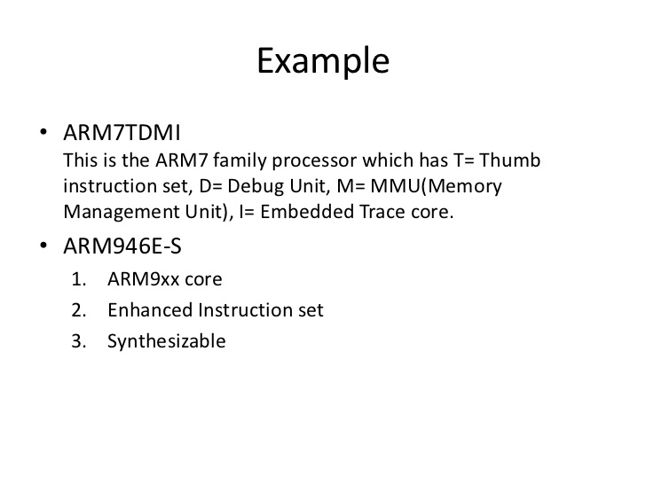

Slide 12
Main features of the
ARM Instruction Set
All instructions are 32 bits long.
Most instructions execute in a single cycle.
Every instruction can be conditionally executed.
A load/store architecture
  Data processing instructions act only on registers
    Three operand format
    Combined ALU and shifter for high speed bit manipulation
  Specific memory access instructions with powerful auto-indexing addressing modes.
    32 bit and 8 bit data types and also 16 bit data types on ARM Architecture v4.
    Flexible multiple register load and store instructions
Instruction set extension via coprocessors

Slide 13
Processor Modes
The ARM has seven operating modes:
  User : unprivileged mode under which most tasks run
  FIQ : entered when a high priority (fast) interrupt is raised
  IRQ : entered when a low priority (normal) interrupt is raised
  SVC : (Supervisor) entered on reset and when a Software Interrupt
  instruction is executed
  Abort : used to handle memory access violations
  Undef : used to handle undefined instructions
  System : privileged mode using the same registers as user mode
Notes:
The Programmers Model can be split into two elements - first of all, the processor modes and secondly, the processor registers. So let’s start by looking at the modes.
Now the typical application will run in an unprivileged mode know as “User” mode, whereas the various exception types will be dealt with in one of the privileged modes : Fast Interrupt, Supervisor, Abort, Normal Interrupt and Undefined (and we will look at what causes each of the exceptions later on).
NB - spell out the word FIQ, otherwise you are saying something rude in German!
One question here is what is the difference between the privileged and unprivileged modes? Well in reality very little really - the ARM core has an output signal (nTRANS on ARM7TDMI, InTRANS, DnTRANS on 9, or encoded as part of HPROT or BPROT in AMBA) which indicates whether the current mode is privileged or unprivileged, and this can be used, for instance, by a memory controller to only allow IO access in a privileged mode. In addition some operations are only permitted in a privileged mode, such as directly changing the mode and enabling of interrupts.
All current ARM cores implement system mode (added in architecture v4). This is simply a privileged version of user mode. Important for re-entrant exceptions because no exceptions can cause system mode to be entered.

Slide 14
ARM Pipelining examples
Fetch: Read Op-code from memory to internal Instruction Register
Decode: Activate the appropriate control lines depending on Opcode
Execute: Do the actual processing

Slide 15
The Instruction Pipeline
The ARM uses a pipeline in order to increase the speed of the flow of instructions to the processor.
  Allows several operations to be undertaken simultaneously, rather than serially.
Rather than pointing to the instruction being executed, the
PC points to the instruction being fetched.
ARM
PC
FETCH
Instruction fetched from memory
PC - 4
DECODE
Decoding of registers used in instruction
PC - 8
EXECUTE
Register(s) read from Register Bank
Shift and ALU operation
Write register(s) back to Register Bank
Notes:
Each instruction is one word (or 32 bits)
Thus each stage in pipeline is one word
In other words 4 bytes, hence the offsets of 4 and 8 used here.
Most instructions execute in a single cycle
Helps to keep the pipeline operating efficiently - only stalls if executing instruction takes several cycles.
Thus every cycle, processor can be loading one instruction, decoding another, whilst executing a third.
Typically the PC can be assumed to be current instruction plus 8
Cases when not case include
When exceptions taken the address stored in LR varies - see Exception Handling module for more details.
When PC used in some data processing operations value is unpredictable - see datasheet

Slide 16
Pipelining :
https://www.slideshare.net/black_pearl/arm-processor?next_slideshow=1.
Note: Slides from 63 to 78 only.

Slide 17
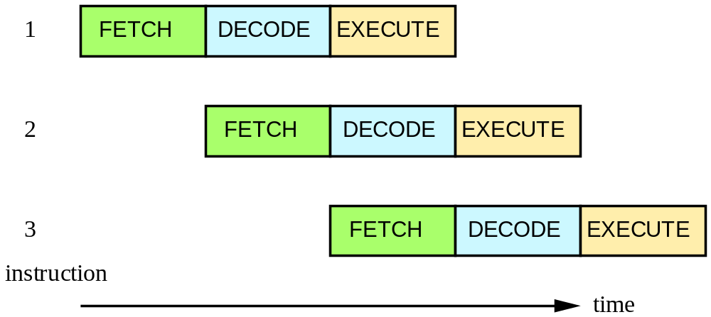
ARM7TDMI Pipelining
Simple instructions (like ADD) Complete at a rate of one per cycle

Slide 18
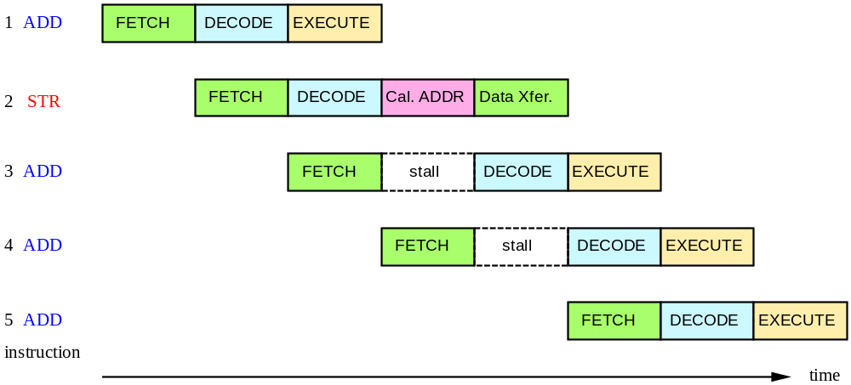
ARM7TDMI Pipelining
More complex instructions:
STR : 2 effective clock cycles (+1 cycle)

Slide 19
Pipeline changes for ARM9TDMI
ARM7TDMI
Instruction
Fetch
ARM decode
Reg
Read
Reg
Write
Thumb→ARM
decompress
Shift
ALU
Reg Select
FETCH
DECODE
EXECUTE
ARM9TDMI
ARM or Thumb
Inst Decode
Instruction
Fetch
Shift + ALU
Memory
Access
Reg
Write
Reg
Decode
Reg
Read
FETCH
DECODE
EXECUTE
MEMORY
WRITE
Notes:
Pipeline Comparison
The point of this foil is to show that with the ARM7TDMI a lot of work was carried out in the execute stage of the pipeline. Now with ARM9TDMI the execute stage has been split out into three stages to allow greater throughput.
This then means the CPI is about 1.5 compared against 1.9 for ARM7TDMI, and the operating frequency is approximately double for ARM9TDMI over ARM7TDMI on the same fabrication process. Therefore, at least double the processing power is available.
It is possible for the pipeline to interlock. Forwarding paths have been provided to minimise this as much as possible, but they can still occur. By using a bit of consideration when writing code they can almost be eliminated.

Slide 20
ARM10 vs. ARM11 Pipelines
ARM10
Branch
Prediction
ARM or
Thumb
Instruction
Decode
Reg Read
Shift + ALU
Memory
Access
Reg
Write
Instruction
Fetch
Multiply
Multiply Add
FETCH
ISSUE
DECODE
EXECUTE
MEMORY
WRITE
ARM11
Shift
ALU
Saturate
Write
back
Fetch
1
Fetch
2
Decode
Issue
MAC
1
MAC
2
MAC
3
Address
Data
Cache
1
Data
Cache
2
Notes:
ARM10 - It just illustrates that another stage was added to the ARM9’s pipeline to provide additional time to handle coprocessor instruction decode and handle branch prediction. The Multiplier is now broken up over two stages, execute and memory, since the multiplier is also pipelined.
Note that the ARM9E multiplier is also pipeline (like ARM10) so the upper diagram strictly only applies to the ARM9TDMI.
ARM11 - The processor is a single issue processor, meaning that only one instruction per cycle can be issued from the issue stage to one of the 3 backend pipeline stages.
While the instructions are issued in order they may complete out of order. This will be depend on availability of data, length of execution and memory access times.

Slide 21
Example ARM-based System
32 bit RAM
Peripherals
16 bit RAM
Interrupt
Controller
I/O
nIRQ
nFIQ
ARM
Core
8 bit ROM
Notes:
This slides shows a very generic ARM based design, that is actually fairly representative of the designs that we see being done.
On-chip there will be an ARM core (obviously) together with a number of system dependant peripherals. Also required will be some form of interrupt controller which receives interrupts from the peripherals and raised the IRQ or FIQ input to the ARM as appropriate. This interrupt controller may also provide hardware assistance for prioritizing interrupts.
As far as memory is concerned there is likely to be some (cheap) narrow off-chip ROM (or flash) used to boot the system from. There is also likely to be some 16-bit wide RAM used to store most of the runtime data and perhaps some code copied out of the flash. Then on-chip there may well be some 32-bit memory used to store the interrupt handlers and perhaps stacks.

Slide 22
An Example AMBA System
AMBA: Advanced Microcontroller Bus Architecture
High Performance
ARM processor
APB
UART
High
Bandwidth
External
Memory
Interface
APB
Bridge
Timer
AHB
Keypad
High-bandwidth
on-chip RAM
DMA
Bus Master
PIO
Low Power
Non-pipelined
Simple Interface
High Performance
Pipelined
Burst Support
Multiple Bus Masters
Advanced Peripheral Bus (APB), Advanced High-performance Bus (AHB)

Slide 23
AMBA systems are based around two buses, a high performance system bus and a lower performance peripheral bus.
The high performance bus (AHB) should connect all of the high performance, high bandwidth modules, such as the ARM Processor, any DMA engines, perhaps some fast, 32 bit wide local RAM (or wider to suit the ARM Bus Master being used), an external memory interface, and the interface to the lower performance bus. The number of modules connected here should be kept to a minimum to reduce the bus loading on this high performance bus and allow it to run much faster.
The bulk of the design modules are placed on the lower performance Peripheral Bus (APB). Modules placed here are not accessed as frequently as AHB modules, and as a result of the APB timing, need not consume power (in their APB interfaces) when there is no APB activity. The address and data bus widths on the APB only need to be as wide as required, compared to the AHB where the maximum address and data widths are specified to maximize system performance in this critical area.
So when a design is being partitioned, the main design criteria are
AHB APB
High Performance Low Power
Frequent Access Simple Interface
Pipelined timing Non-pipelined
We don’t go into multi-layer AHB, AHB Lite or any other AMBA configurations in this presentation.

